Slide 1
Banking & Finance Law
Legal briefings and practical notes

Slide 2
Internal regulations
Independent audit
Internal audit, internal control
Special control
Prudential ratios

Slide 3
Independent audit (Cir 39/2011/TT-NHNN on independent audit of CI/FBB as amended by Cir 24/2021/TT-NHNN)
Independent audit of the operation of internal control system (internal mechanisms, policies, processes, regulations and organizational structure)
Independent audit of FSs: (a) accounting balance sheet; (b) business result report; (c) cash flow report; and (d) explanatory notes on FSs
Independent audit firm must be qualified (Art. 11)
Responsibility of CI/FBB (Art. 15):
- Send the notice of the selected independent auditor to central SBV & local SBV within 30 days
- Within 90 days from fiscal year end, submit the results of independent auditing (enclosed with the conclusion made by an independent audit firm, audited report, management letter & related docs) to central SBV& local SBV
- Redo the audit in case of the negative auditing opinion
- Execute the public disclosure of financial information

Slide 4
Internal audit, internal control (Circular 13/2018/TT-NHNN dated 18/5/2018 on internal control system of CI/FBB, as amended by Circular 40/2018/TT-NHNN dated 28/12/2018)
Requirements for the internal control system
Filing of documents on internal control systems
Report to SBV on internal control systems
Requirements for the internal control itself
Compliance Function
Risk Management Function: Requirements as to and internal regulations on Risk Management
Requirements and strategies for credit risk management and credit risk limits
Market risk management strategy and market risk limits
Operational risk management strategy, and operational risk limits

Slide 5
Internal audit, internal control (cont.)
Requirements and strategies for liquidity risk management & liquidity risk limits
Concentration risk management strategy & concentration risk limits
Interest rate risks in the banking book (IRRBB), risk management strategy & IRRBB limits
Principles of internal auditing
Coordination mechanism
Eligibility criteria for internal audit department
Ethical standards of internal auditors
Organizational structure, tasks, powers & responsibilities of internal audit dept.
Internal audit plan, contents, reports

Slide 6
Special control (Circular No. 11/2019/TT-NHNN dated 02/8/2019 providing for special control over CIs/FBBs)
Power to make decisions on special control of credit institutions
Forms of special control
Extension of special control duration
Termination of special control
Responsibility of credit institution placed under special control, and its owner, capital contributors, shareholders, BOD, BOM, BOC, and GD (or Director)
Insolvency due to low liquid assets or low tier-1 capital adequacy ratio

Slide 7
Prudential ratios (LCI, Circular 22/2019/TT-NHNN dated 15/11/2019, amended by Circular 08/2020/TT-NHNN dated 14/8/2020 and Circular 26/2022/TT-NHNN dated 31/12/2022, Circular No. 41/2016/TT-NHNN dated 30/12/2016)
Liquidity ratio include:
Reserved liquidity ratio: at least 10%; and
Liquidity ratio for following 30 days: 50% for VND and 5% for USD/foreign currencies
Ratio between short-term funds and medium- and long-term loans financed by the short-term funds, under the following schedule:
From 1st Jan, 2020 to the end of Sep 30, 2021: maximum 40%
From 01 Oct, 2021 to the end of Sep 30, 2022: maximum 37%;
From 01 Oct, 2022 to the end of Sep 30, 2023: maximum 34%
From 01 Oct, 2023: maximum 30%
Minimum capital adequacy ratio: 9%
Maximum ratio of loan outstanding over deposit balance: 85%.
Maximum ratio of purchasing, investing to governmental bonds, bonds guaranteed by Govt.: 30%

Slide 8
Banking operations
Deposit taking
Credit extension
Via-account payment

Slide 9
Deposit taking: receiving money from an organization or individual in form of demand or term deposit, savings deposit, issuing deposit certificates, bills or treasury bills, and other forms of receiving deposits on the principles of full payment of principals and interests to depositors under agreement
Cir. 48/2018/TT-NHNN (saving deposits)
Cir. 49/2018/TT-NHNN (term deposits)
Cir. 23/2014/TT-NHNN (on the opening & use of payment accounts, as amended)
Cir. 04/2022/TT-NHNN (interest rate in case of premature withdrawal of deposits)
Cir. 01/2014/TT-NHNN (guiding the delivery, receipt, preservation and transport of cash, precious assets and valuable papers) (as amended)
Cir. 22/2022/TT-NHNN on prudential ratios & limits
SBV’s Official Letters issued from time to time

Slide 10
Deposit taking (cont.)
Deposit currency
Eligible depositors
Procedures for making deposits at CIs
Premature withdrawal of deposits
Procedures for paying out deposits at CIs
Agreement on term deposit
Deposit term extension
Internal regulations
Public posting

Slide 11
Questions
How many forms of deposits eligible for premature withdrawal?
Only demand deposit
Demand deposit and time deposit
Any form of deposits
A few certain forms

Slide 12
Questions (cont.)
What is the maximum loan-to-deposit (LDR) ratio that a bank needs to maintain?
80%
85%
90%
100%

Slide 13
Questions (cont.)
Which of the following reflects the profitability of a credit institution?
LDR (Loan-to-Deposit Ratio)
CASA (Current Account – Savings Account
CAR (Capital Adequacy Ratio)
NIM (Net Interest Margin)

Slide 14
Credit extension
Lending
Discounting
Financial leasing
Factoring
Bank guarantee
Other credit extension operations

Slide 15
Lending
General regulations:
Civil Code No. 91/2015/QH13, passed by the NA on 24/12/2015
LCI, as amended
Ordinance on Foreign Exchange No. 28/2005/PL-UBTVQH11, passed by the Standing Committee of NA on 13/12/2005, as amended and supplemented by Ordinance No. 06/2013/UBTVQH13 passed by the Standing Committee of NA on 18/3/2013

Slide 16
Specific regulations
Offshore loan
Decree No. 219/2013/ND-CP of the Government dated 26 December 2013 on management of offshore loans without Government guarantee.
Circular 08/2023/TT-NHNN dated 30/6/2023 (replacing Circular 12/2014) guiding the conditions for offshore loans without Government guarantee
Circular 12/2022/TT-NHNN dated 30/9/2022 (replacing Circular 03/2016) on foreign exchange control over offshore borrowing and payment by enterprises

Slide 17
Specific regulations (cont.)
2. Onshore loan
Circular No. 39/2016/TT-NHNN dated 30/12/2016 regulating [onshore] lending by credit institutions and foreign bank branches to clients (as amended by Cir. 06/2023 dated 28/6/2023, and further amended by Cir. 10/2023 dated 23 Aug 2023)
Circular No. 14/2017/TT-NHNN dated 29/9/2017 on methods of calculating interest on depositing and credit extension transaction between credit institutions and customers
Circular No. 22/2019/TT-NHNN of SBV dated 15/11/2019 on limits and prudential ratios of banks and foreign bank branches

Slide 18
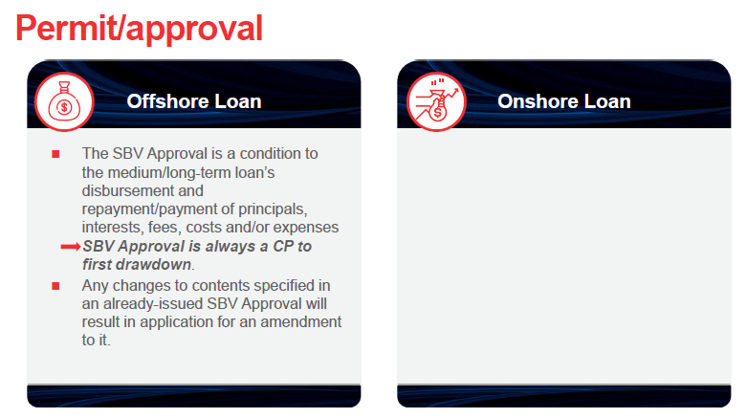
Permit/approval

Slide 19
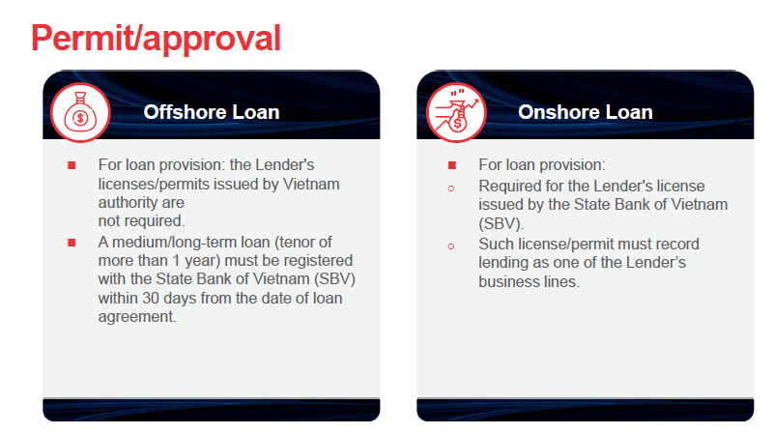
Permit/approval (cont.)

Slide 20
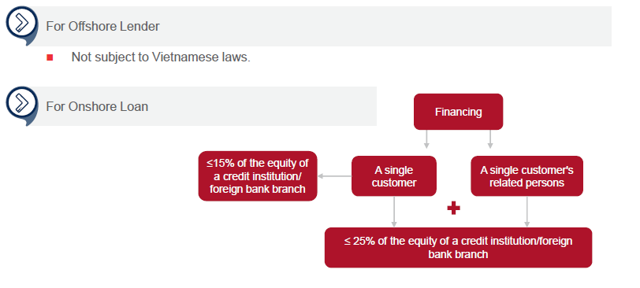
Lending limits

Slide 21
Borrowing limits
1. Borrower being an FDI company
Mid/long term loans: borrowing limits (including onshore and offshore debts) ≤ investment capital - contributed charter capital (as indicated in the Borrower’s IRC)
Short term loan: no limit
2. Borrower being a domestic company:
Mid/long term loans: borrowing limits (including onshore and offshore debts) (including short-term loans that are extended and overdue short-term loans that are treated as medium/long-term loans) ≤ total demand for borrowed capital defined in its plan for use of foreign loan capital approved by an authorized approving authority
Short term loan: no limit

Slide 22
Borrowing limits (cont.)
3. Borrower being an CI
Mid/long term loan: no limit but still has to comply with prudential ratios set out under the LCI
Short term loan (applied from 1 Jan 2024): A borrower may apply for a short-term foreign loan if it meets the limit on short-term foreign loans as at December 31 of the year preceding the year in which the loan application is submitted. The limit on short-term foreign loans is the maximum ratio of total outstanding principal of short-term foreign loans to standalone equity, and shall not exceed:
- 30% if the borrower is a commercial bank; or
- 150% if the borrower is a FBB or another credit institution.

Slide 23
Offshore borrowing purpose What can do? (Art. 17, Cir 08)
Restructuring its foreign debts and paying its short-term debts payable in cash (excluding outstanding principal amounts of domestic loans)
Short term loan
Use for its business operations within a maximum duration of 12 months from the day on which the foreign loan capital is withdrawn (those required to ensure prudential financial ratios, e.g. securities companies)
FDI or domestic borrower
Implementing investment projects
Medium/long term loan
Implementing business plans or other projects
Restructuring its foreign debts

Slide 24
Offshore borrowing purpose (cont.) What can do? (Art. 14, Cir 08)
Increasing the borrower’s funding for credit extension activities to meet its credit growth target
CI or FBB (for both short term and medium/long term loan)
Restructuring the borrower’s foreign debts

Slide 25
Onshore borrowing purposes What can’t do? (Art. 8, Cir. 39 as amended)
1. Loan used for investing in sectors or activities prohibited by Investment Law
2. Loan used for paying expenses or meeting financial demands of transactions or acts which are prohibited by Investment Law/other laws
3. Loan used for purchasing or using goods or services in the list of sectors or activities prohibited by Investment Law
4. Loan used for buying gold bullions
5. Loan used for repaying loan debts owed to lending CI, except for those used for paying loan interest arising during the construction process of which cost is accounted for in the construction cost estimate approved by a regulatory authority in accordance with laws.

Slide 26
Onshore borrowing purposes What can’t do? (Art. 8, Cir. 39 as amended)
6. Loan used for repaying loan debts (excluding offshore loans in form of goods sale/purchase with deferred payment), loans granted by other CIs, unless it is used for prepayment of a debt and it satisfies all the following requirements:
a) Having a tenor not exceeding the residual tenor of the refinanced loan;
b) [the refinanced loan] has not yet been subject to a debt rescheduling
7. Loan used for placing deposits
8. Loan used for paying capital contribution, capital acquisition, capital transfer, etc.

Slide 27
Onshore borrowing purposes What can’t do? (Art. 8, Cir. 39 as amended)
9. Loan used for paying capital contributions under capital contribution agreement, investment/business cooperation contract for implementing investment projects which do not satisfy conditional business requirements
10. Loan used for covering financial shortfalls unless such loan fully meets the following conditions:
a) The customer has used their own funds for paying costs incurred from their business project for a period of less than 12 months by the time of grant of lending decision by CI;
b) Costs paid using the customer’s funds for executing a business project are costs to be covered using the fund borrowed from CI under the plan to use borrowed fund submitted to the credit institution when applying for a medium-term or long-term loan for executing that business project.

Slide 28
Case discussion
An FDI wants to acquire a joint venture’s equity which had been contributed in form of cash, factory, machines and land use right. The FDI approaches an FBB for an onshore loan to finance the equity acquisition.
Is the proposed loan purpose permitted by law?
What kind of documents we need to review?
What are the key issues we need to consider before deciding to grant an onshore loan to such FDI?

Slide 29
Other notable issues
Account bank (as to offshore loans)
Security servicing bank (as to secured offshore loans)
Fees that can be collected relating to onshore and offshore loan)

Slide 30
Questions for discussions
Is it allowed to take offshore loan funds to buy shares or contribute capital into another enterprise or into a subsidiary of the borrower?
If it is allowed, which specific loan purpose is to be specified?
Is there any other additional conditions, aside to such loan purpose requirements?
Is it possible to use offshore loans to pay onshore loans?

Slide 31
Questions for discussions (cont.)
5. Is it allowed to take onshore loan funds to buy shares or contribute capital into another enterprise or into a subsidiary of the borrower
6. Is there any requirement to deduct or withhold tax from any amounts to be paid or repaid to a lender (whether domestic or foreign)?
7. Are there any registration, notarization or reporting requirements in relation to offshore and onshore loans?
8. Is it the responsibility of the lender or the borrower to handle such registration, notarization or reporting requirements?

Slide 32
Discounting
Discounting by CIs/FBBs for their customers: Circular 04/2013/TT-NHNN dated 1 March 2013 (as amended)
- Principles, conditions
- Currency
- Method, procedure
- Contents of the discounting contract
- Classifying assets, levels and methods of setting up provisions and using provisions for risk control
2. Discounting by SBV for CIs/FBBs:
- Guided by Circular 01/2012/TT-NHNN dated 16 February 2012
- Conditions for CIs/FBBs participating in discounting operations (Art. 8, Cir 01)

Slide 33
Financial leasing
Decree 39/2014/ND-CP dated 7/5/2014 on operation of financial companies and financial leasing companies (as amended)
Circular 20/2017/TT-NHNN dated 29/12/2017 on sale of receivables from financial leasing contract

Slide 34
Factoring
Civil Code 2015
Circular 02/2017/TT-NHNN dated 17/5/2017 on factoring services provided by credit institutions and branches of foreign banks

Slide 35
Bank guarantee
Vietnam’s Specific Commitments to WTO in Services (for cross-border transactions)
Circular 11/2022/TT-NHNN dated 30/9/2022
Investment Law
Law on Real Estate Business
LCI

Slide 36
Other credit extension operations
Other credit extensions defined by SBV from time to time
Including credit extensions derived from capital sources of other juridical persons, the risks of which are taken by CI or FBB
It can be a structured finance in reference to international practices

Slide 37
Taking security in Vietnam
Civil Code No. 91/2015/QH13
Decree 21/2021/ND-CP dated 19/3/2021 regulating the implementation of the Civil Code on security of performance of obligations
Decree 99/2022/ND-CP dated 30/11/2022 on registration of security interests
Decree No. 91/2018/ND-CP dated 26/6/2018 regarding the issuance and management of Govt. guarantee
Circular No. 11/2022/TT-NHNN dated 30/9/2022 => Bank guarantee
Circular No. 08/2018/TT-BTP of the Ministry of Justice ("MOJ") dated 20/6/2018 => Movable properties (except for aircrafts and vessels) security registration
Circular No. 07/2019/TT-BTP of the MOJ dated 25/11/2019 => Immovable properties (including future immovable properties) security registration
Circular No. 01/2019/TT-BTP of the MOJ dated 17/01/2019 => Aircrafts and vessels security registration

Slide 38
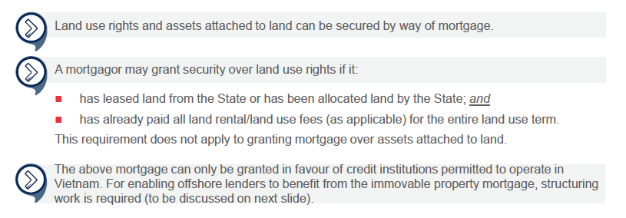
Taking security in form of immovable property mortgage

Slide 39
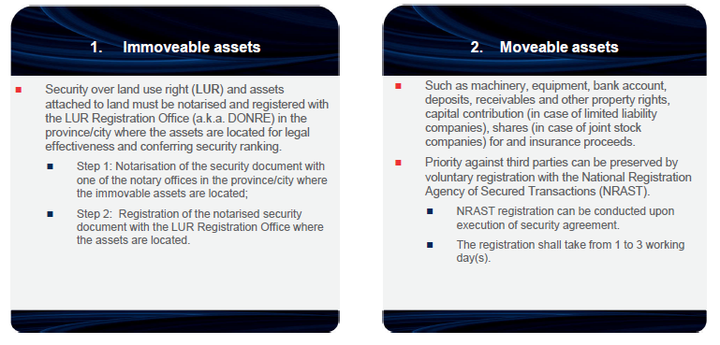
Security creation and perfection (1/3)

Slide 40
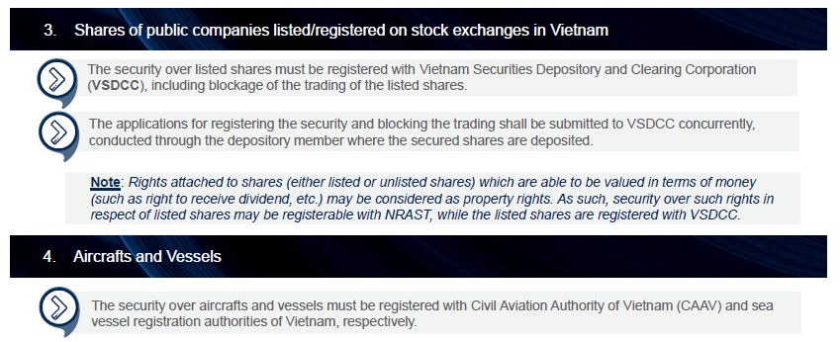
Security creation and perfection (2/3)

Slide 41
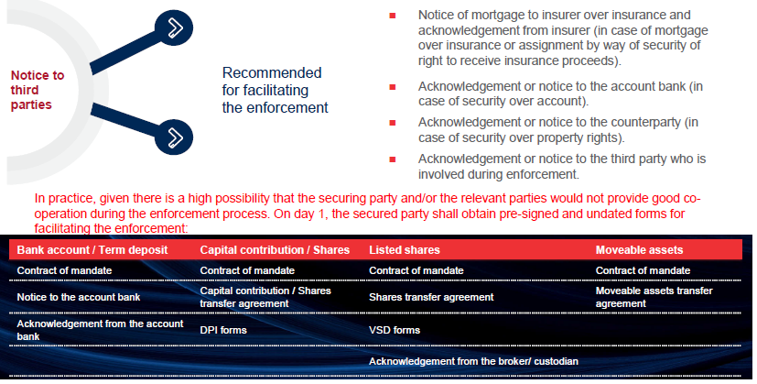
Security creation and perfection (3/3)

Slide 42
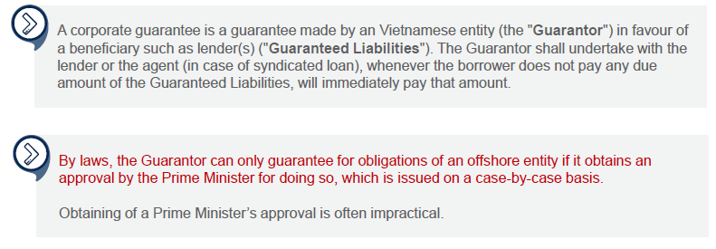
Corporate guarantee (1/2)

Slide 43
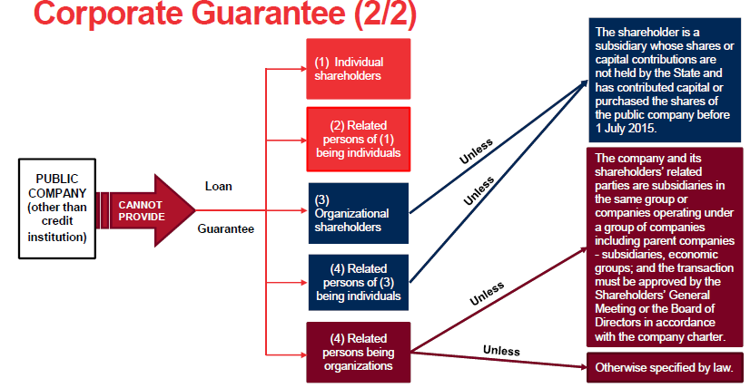
Corporate guarantee (2/2)

Slide 44
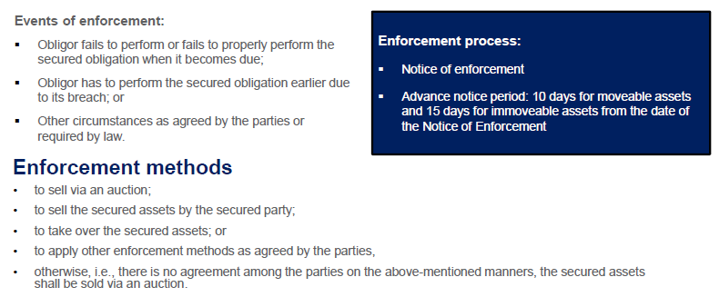
Enforcement (Enforcement of a solvent borrower)

Slide 45
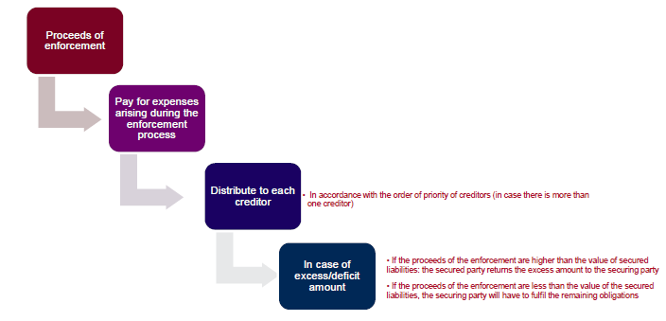
Enforcement (Application of monies)

Slide 46
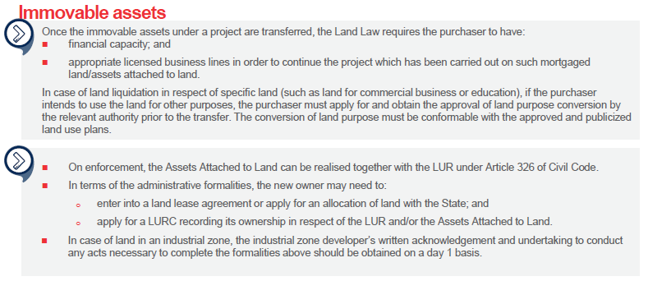
Obstacles during the enforcement

Slide 47
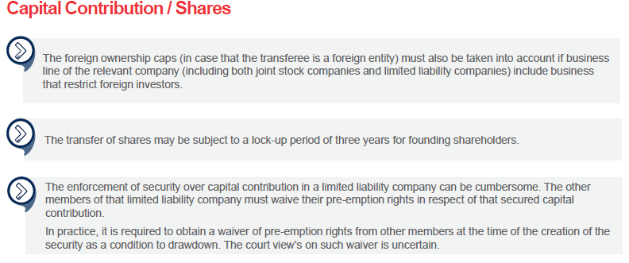
Obstacles during the enforcement (cont.)

Slide 48
Via-account payment
Decree 101/2012/NĐ-CP dated 22/11/2012 on non-cash payments (as amended)
Circular 23/2014/TT-NHNN dated 19/8/2014 on opening and use of payment accounts at payment service providers (as amended)
Circular 39/2014/TT-NHNN dated 11/12/2014 guiding the intermediary payment services (as amended)
Circular 46/2014/TT-NHNN dated 31/12/2014 guiding non-cash payment services
Circular 19/2016/TT-NHNN dated 30/6/2016 on bank card operations (as amended)
Circular 20/2018/TT-NHNN dated 30/8/2018 prescribing oversight and supervision of payment systems
Other relevant regulations

